Slide 1

Data Mesh for Healthcare
Adopting a distributed enterprise data architecture to eliminate the challenges of data availability and accessibility at scale
Jey Paulraj
Chief Technologist - Customer led co-innovation CTO Org-Red Hat
jpaulraj@redhat.com

Slide 2
Today’s data management approach delays analytics
80%
Business has a question
Data Engineering services the request
Business gets an answer
ETL
Data Warehouses
Data Lake
Database
Multiple Copies
Cloud Data
Warehouse
Cloud Data
Lake
Delays decision-making, increases data costs & complexity
Notes:
Before we go deeper into the benefits that a data mesh on a distributed architecture will bring to your organization, let’s first take a look at the root of the problems you are facing
Data ecosystems are becoming more complex, especially as cloud-based data platforms are added to the mix
This means that the process by which the business gets answers to its questions is also becoming more complex
In a modern data ecosystem, there is massive amounts of data sitting in a variety of locations and formats, like database, data lakes and warehouses, both on prem and in the cloud
In order to effectively analyze the data, it needs to put it in a common format.
This requires you to consolidate it into a single location by moving and/or copying it into that location.
This is extremely time consuming, it can get quite expensive, and it adds 0 value while also increasing security risks by having multiple copies of your data laying around.
Ultimately what it drives down is your ability to provide insights at the speed of business. 80% of an enterprise’s time is spent on making the data available for analysis - 20% is spent on finding the answers to their questions

Slide 3
4 Pillar of Data Mesh
Domain Ownership
Data as a Product
Self Serve Data platform
Federated Governance
Domain Bounded Context
Thinking as Product
Domain agnostic
Context Mapping
Domain Team
Data Produced by Domain Team
Data Platform Team
Guild
Operational and Analytical Data
Interoperability Interface
Self Serve Data Platform
Data Governance & Automation
Notes:
Latency SLO … look at tracing timeline …
Metrics, tracing, logs

Slide 4
Why Data Mesh ?
Data Warehouses
build consensus upfront model data rigidly, hard to build easy to query
Data Lake
store data as is , leading interpretation to consumer easy to build , but challenging to query
Data Mesh:
decentralizes the problem space
bringing creation closer to producer focus on the need of consumer
reduce platform complexity Leveraging Data as code approach
Notes:
Data as Code is an approach that gives teams — from DevOps to DataOps, Data Scientists and beyond — the ability to process, manage, consume, and share data in the same way we do for code during software development. ... When an application needs to be deployed, a DevOps Engineer simply deploys it via automated pipelines.
In a Data as code approach, all data and data handling logic should be treated as code. Creation, deprecation, and critical changes to data artifacts should go through a design review process with appropriate written documents where the community of contributors as well as data consumers’ views are taken into account. Changes in data sources, schema, pipeline logic have mandatory reviewers who sign off before changes are landed. Data artifacts have tests associated with them and are continuously tested. The same practices we apply to software code versioning and management are employed.

Slide 5











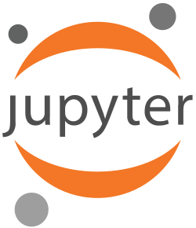


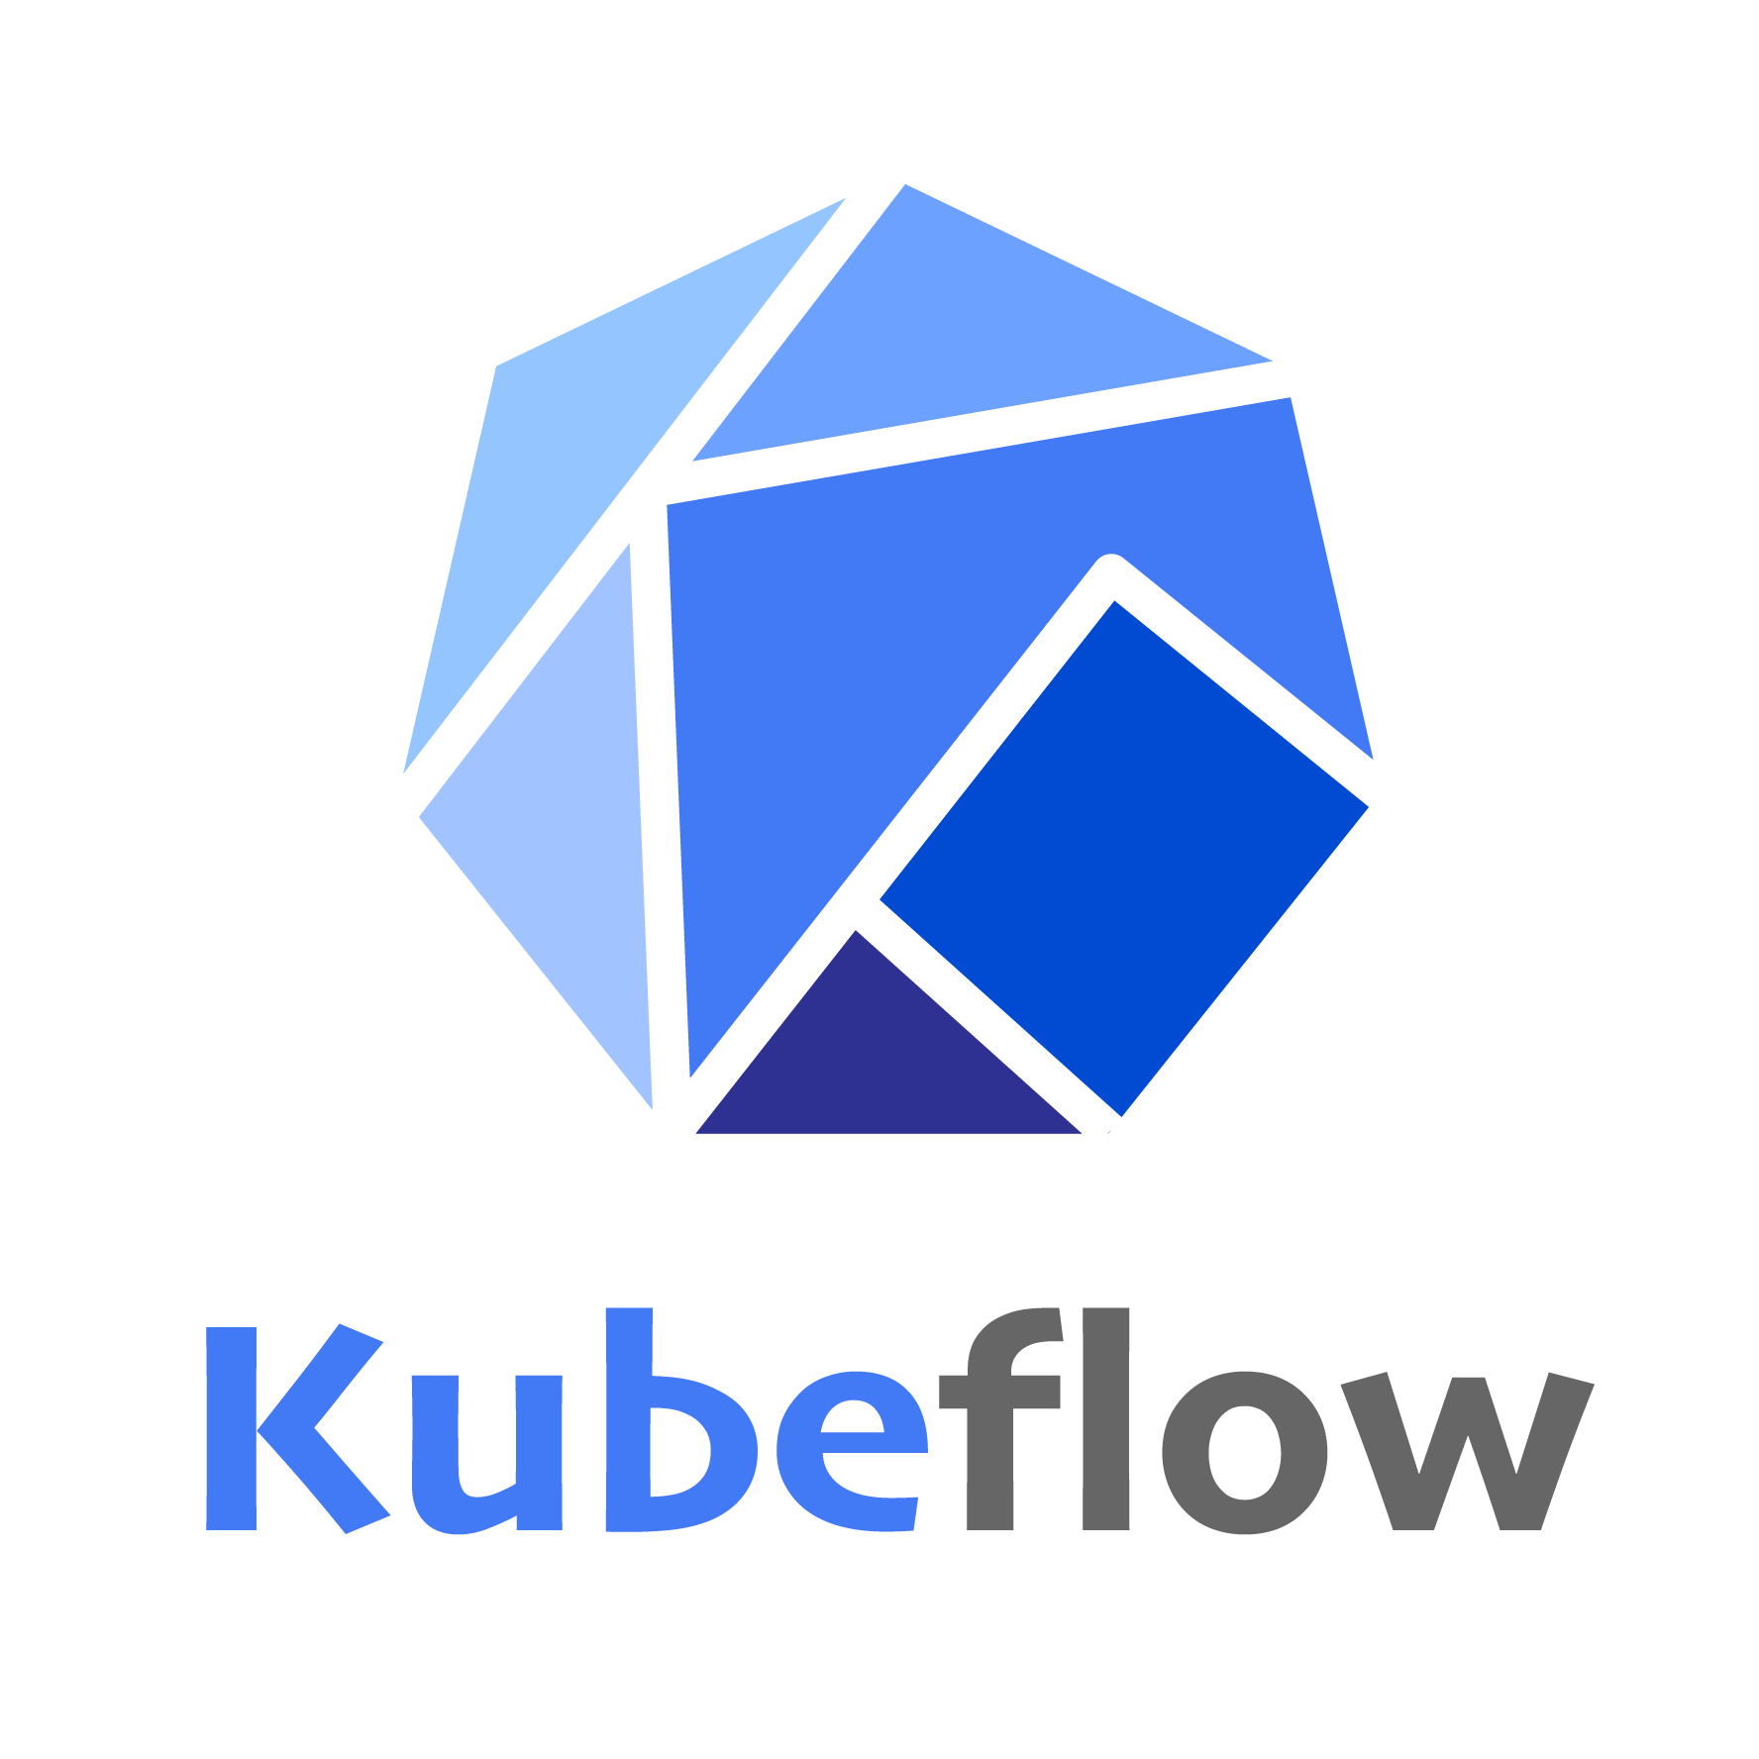






Data Mesh Component Architecture
Data Sources
Data Mesh Pattern
AIOps
Apps
Data management & Governance
Workflow management
Metadata
Management
Data
Security
OTEL Streaming Data
Red Hat OpenShift AI
Data Ingestion
Data Transformation
Transactional Data
Trino
Data Versioning
Distributed Query Engine
Data Streaming
Event Streaming
Data Storage
Object Storage
Data Warehouses
Database
Data Lake

Slide 6
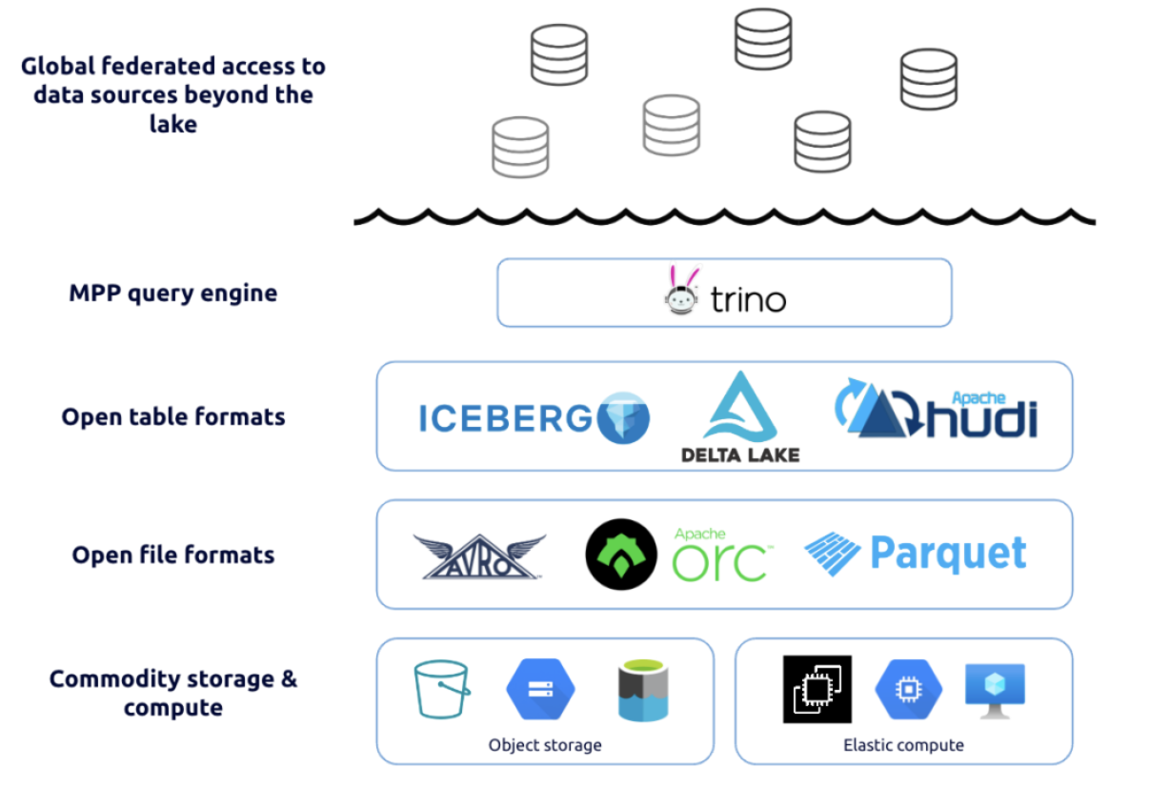
Data Mesh Component Architecture
Modern Data Architecture

Slide 7



Co-innovation Drives Success
Partnering together to realize business objectives
Collaborate
Innovate
Realize

Slide 8
Thank you
Red Hat is the world’s leading provider of enterprise open source software solutions. Award-winning support, training, and consulting services make Red Hat a trusted adviser to the Fortune 500.

